Slide 1
“Graph” in Program Analysis
Chenghang shi

Slide 2
Outline
Warm up for the paper
“Graph” in program analysis
Not detailed
Subjective
Maybe wrong

Slide 3
Warm up for the paper
Anderson Pointer analysis
Constraint Graph
Cycle detection

Slide 4
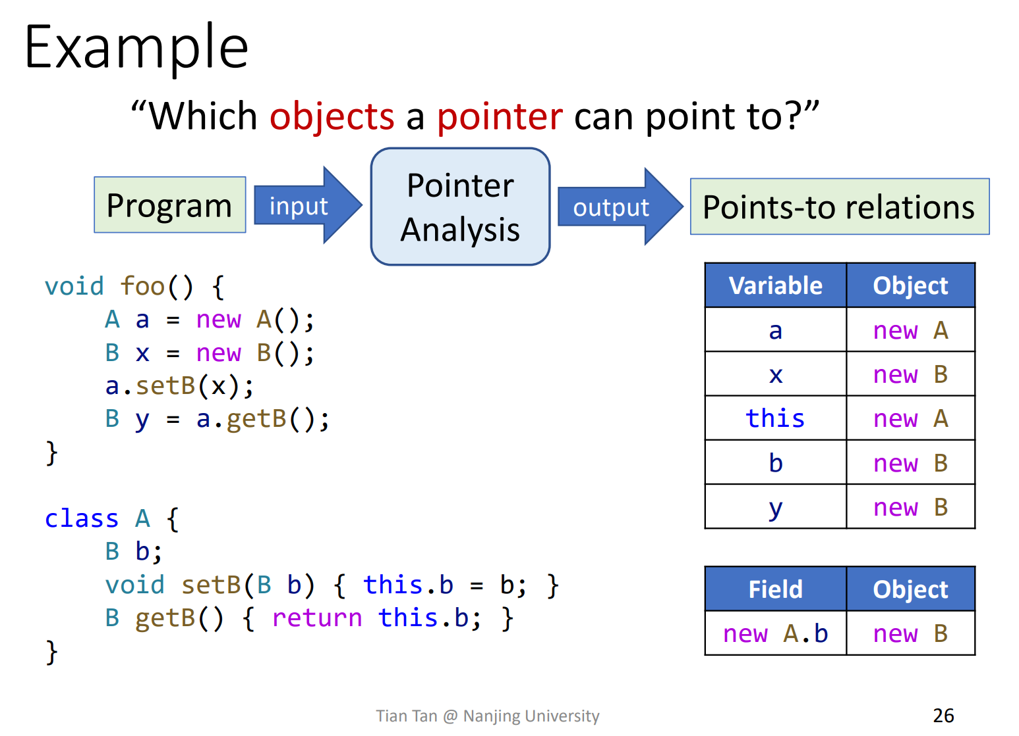
Recap: Anderson pointer analysis

Slide 5
Recap: Anderson pointer analysis
Points-to analysis: determine which subset of memory locations a pointer may points to
Pointer analysis also includes alias analysis
How?
Extract pointer-related statements
Give statements semantics and generate constraints
Solve the constraints

Slide 6
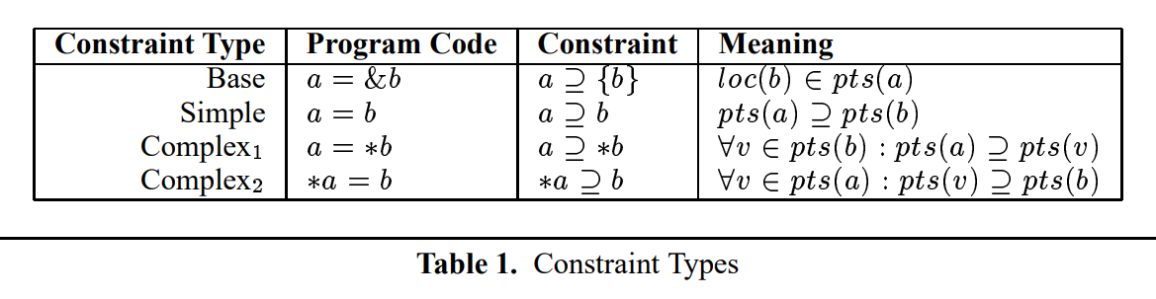
Semantics & constraints
Constraints = Statement Semantics
Solution satisfying all constraints = Desired points-to relation
“Less is better” under constraints

Slide 7
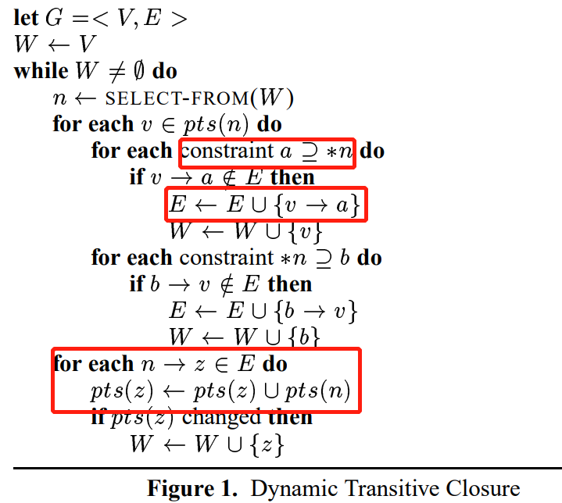
Basic Algorithm of Constraints Solving

Slide 8
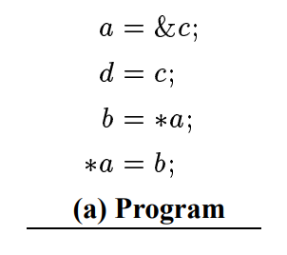
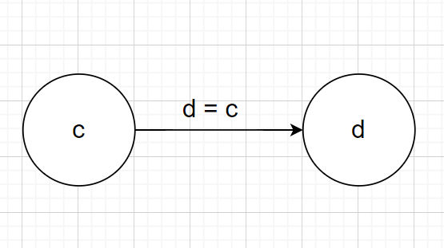
Snapshot of Constraint Graph
“static” edges

Slide 9
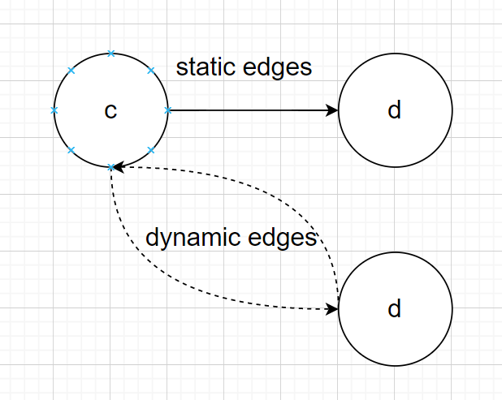
Snapshot of Constraint Graph
“dynamic” edges

Slide 10

Cycle detection in dynamic graph

Slide 11
“Graph” in program analysis
Data structure used in algorithm(e.g. constraint graph)
Graph carrying control/data flow(e.g. CFG/ICFG...)
Graph reachability
Maybe more...

Slide 12
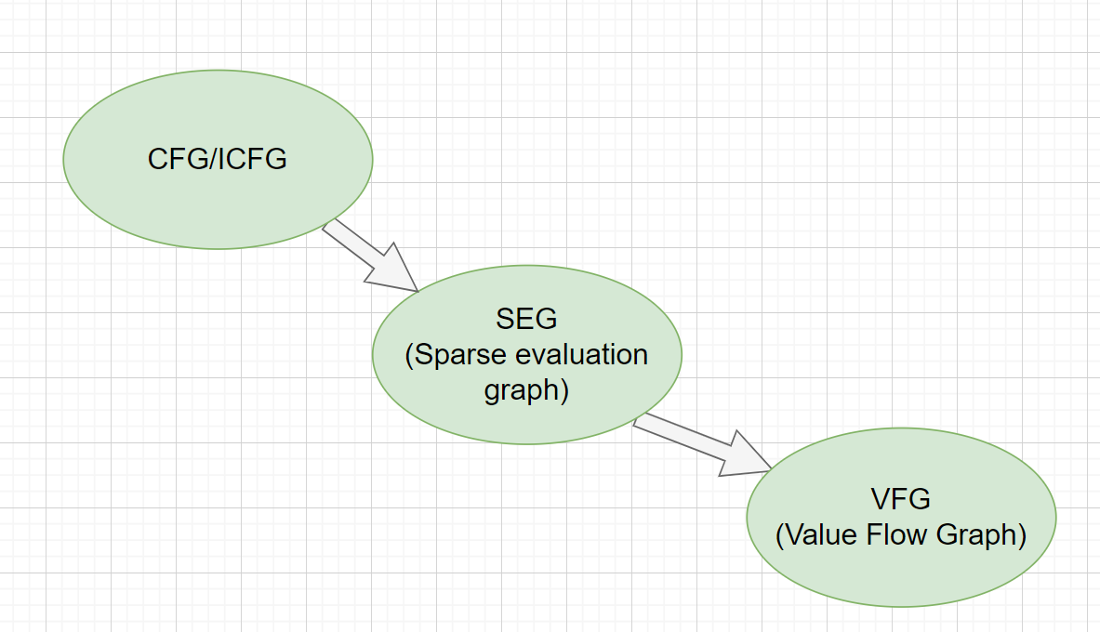
Graph carrying control/data flow
“Sparser”: CFG -> SEG(Sparse Evaluation Graph) -> VFG(Value Flow Graph)

Slide 13
SEG & VFG
SEG: Keep Nodes related to data flow problem
Value Flow Analysis/Value Flow Graph/Memory SSA
Same terminology, not exactly the same things
Basically, want sparser information(e.g. use-define chain)
Keywords(?): flow sensitive, sparse...
Usually for C++/C
Memory SSA in LLVM[9, 10]

Slide 14
Program Analysis via Graph reachability
Graph Reachability, usually refers to CFL(Context Free Language) Reachability
Example: IFDS
Implementation: FlowDroid, a taint analysis tool
Extension: IDE
Sparse IFDS...

Slide 15
Recap: CFL Reachability
In IFDS, used to match call and return
Why?
Filter spurious data flow(unmatched call & return)
More use cases?
Match load & store(Flow-insensitive Pointer Analysis)
Interprocedural Slicing
...

Slide 16
Thanks for Listening

